Slide 1
CNN changes

Slide 2
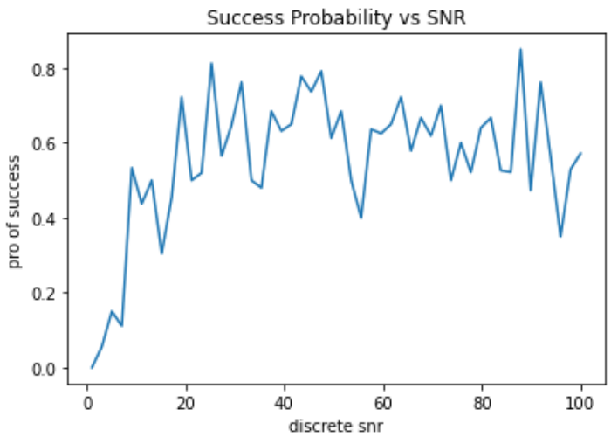
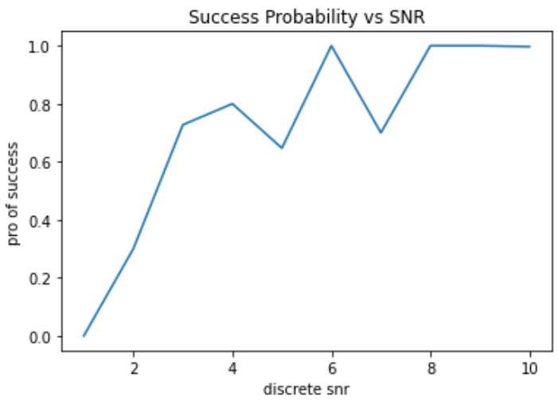
200 measurements---cause by drift16.7 minutes
Before optimize
After some optimization

Slide 3
Why only 200 iterations
How:
1000 = 5 * 200
Use the predicted location from last iteration as the center of next iteration
Data:
1st iteration: 0.93 2nd iteration: 0.006 3rd iteration: 0.745 4th iteration: 0.002 5th iteration: 0.335
Reason of failing: We didn’t train the CNN model outside the cube

